Slide 1
Self Exploration as the process for Value Education UNIT-1, Ch-2
Professor & Lawyer Puttu Guru Prasad

Slide 2

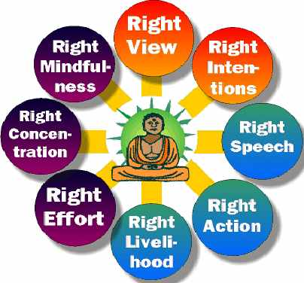

Slide 3
Professor & Lawyer
Puttu Guru Prasad
B.Com., M.Com., M.Phil., M.B.A., PGDFTM., AP.SET., M.Phil., DRMS., L.L.B., ICFAI TMF., DIRM., L.L.M., PhD Scholar JNTUK., Domain Topper & 30th Batch Topper at ICFAI -2009 Training for Management Faculty
“Diploma in Psychology from YALE University”
MHRDI’s 'Institution's Innovation Council (IICs)Ambassador
NSS Certified Program Officer, (A.U) ICFAI UNIVERSITY Trained Senior Faculty
Senior Faculty for Business Studies, Economics, Accounts
Head, Board of Law & Management Science,
BHAGAVAD GITA & CLAT & IPMAT Program Coordinator,
S&H Department, VIVA-VVIT, Nambur,
My Blog: puttuguru.blogspot.in
My Web Site: https://gurublogs.wixsite.com/guru
93 94 96 98 98, 9885 96 36 36, 807 444 9539,

Slide 4
Self Exploration
Self exploration is a process of seeing the truth about a reality on our own right, by our own investigation, observation and analysis.
The first step in to verifying the given proposal on your own right by referring it to your Natural Acceptance.
If the proposal is naturally acceptable to you, it is right for you, if it is not naturally acceptable to you, then it is not right for you

Slide 5
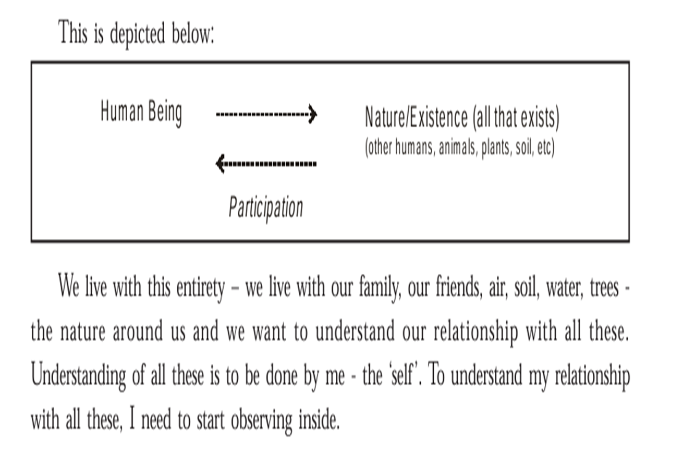

Slide 6

For example:- to be in relationship with your family members or to be in opposition with them.

Slide 7

The Dialogue with in
It is a dialogue between “ what I am” and “what is naturally acceptable to me”
-What I have to do with my desires, my thoughts, my expectation, my imagination and all that is going on within me
-What I really want to be. For example- we can easily see that we want to live in relationship, we want our bodies to be healthy and so on.
-Any contradiction between “what you are” and “what is naturally acceptable to you”, will be a source of Discomfort for you.

Slide 8
The Dialogue with in Yourself
Once this dialogue with in your self has been established , we start to be in harmony with in. This very process of being in this dialogue starts facilitating one’s self evolution and we start becoming more and more comfortable with in. Diagram -2.2 page no:20

Slide 9
The context of Self Exploration
The following two sub-parts A. Desire – Aspiration B. Program – Way to fulfilling the Aspiration

Slide 10
The Process of Self- Exploration
The first part of the self exploration is to verify the proposal on the basis of our natural acceptance
The second part of self exploration is experiential validation- It means trying to live according to the proposal

Slide 11
In living there are two parts
Behavior with others
2. Work with the rest of the Nature
If the above two parts of living leads to mutual happiness and mutual prosperity, then it is the Right Proposal.

Slide 12
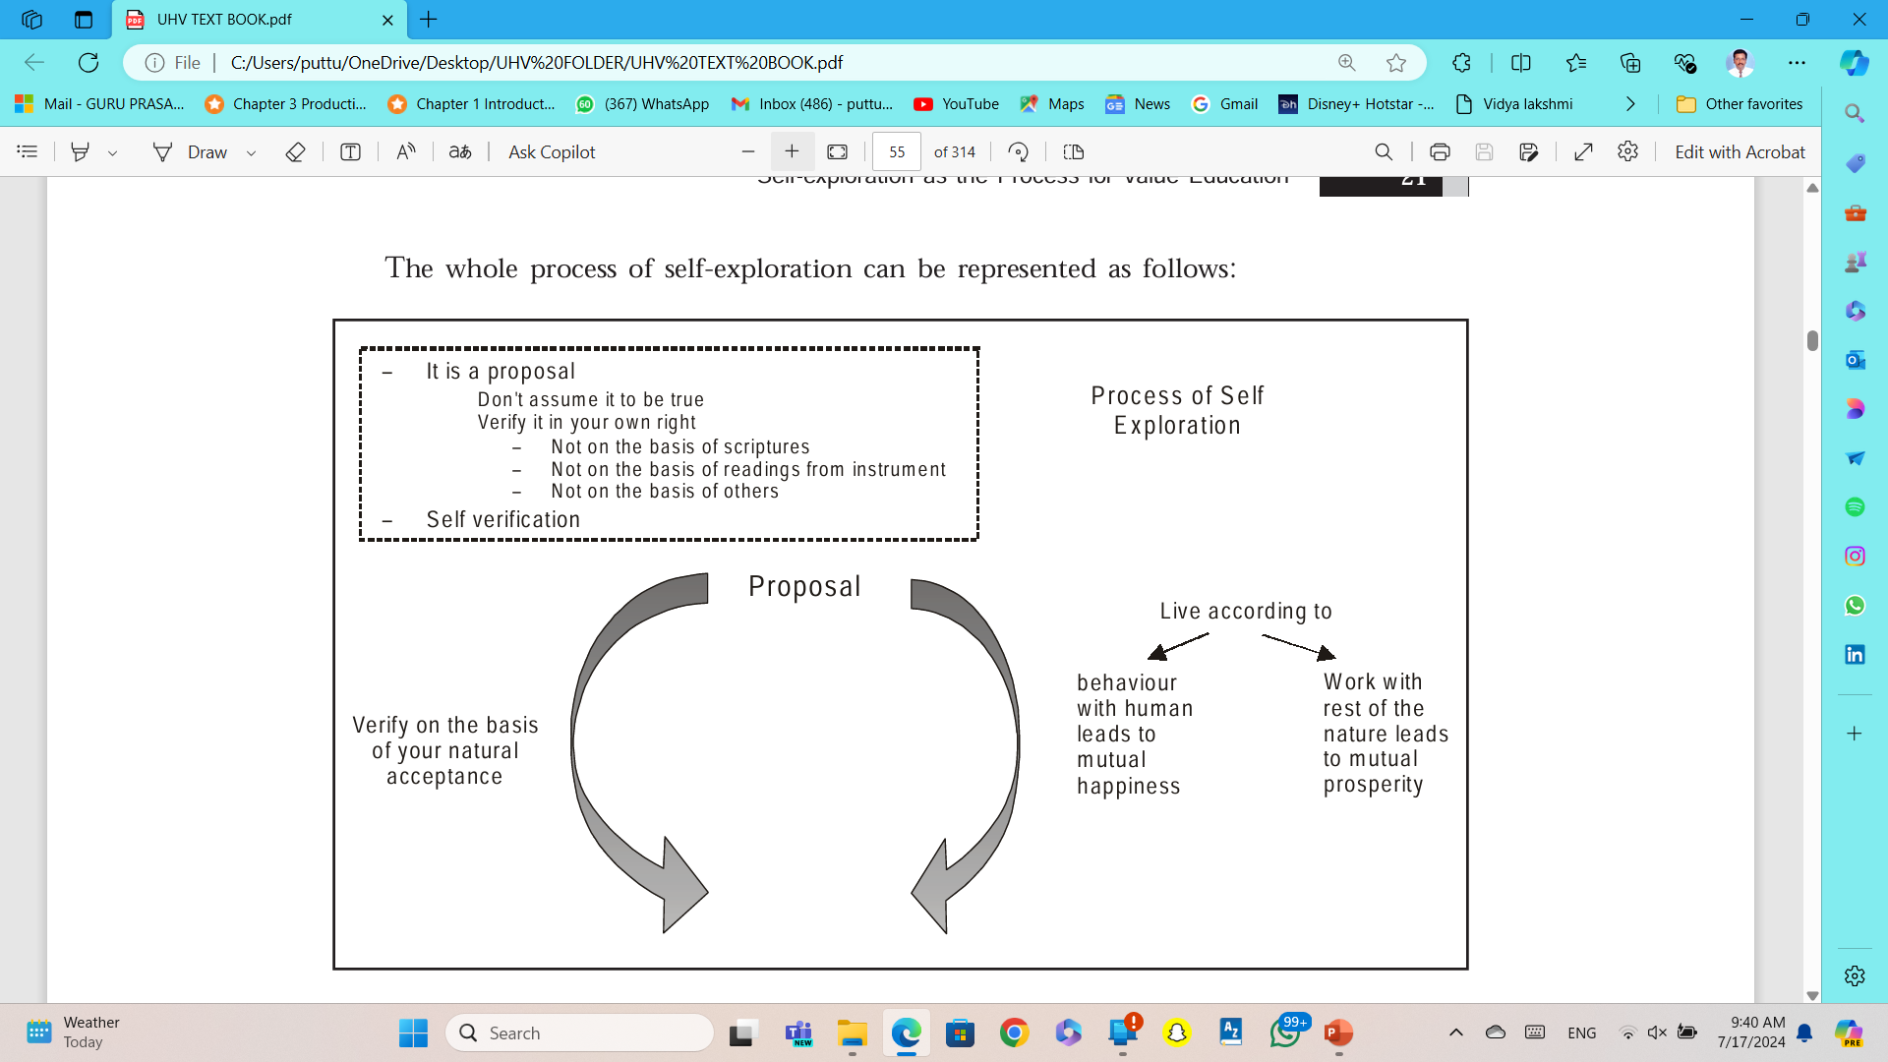

Slide 13

Understanding Natural Acceptance Distinguishing between Acceptance and Natural Acceptance
What is Naturally Acceptable to you- to be happy or unhappy? Whare does the answer comes from: 1. First, It is coming from your likes & dislikes, assumptions, pre-conditioning, beliefs, world-view, perspectives and so on. 2. Second, It is coming from your natural acceptance, example liking for some specific tasty food or chocolate

Slide 14
Natural Acceptance
Natural Acceptance has to do with something fundamental, some thing related to our purpose, some thing related to our basic desires. When we ask questions related to these, we get a definite answers from our natural acceptance. For example, A. Is Happiness naturally acceptable or is unhappiness naturally acceptable? B. Is it naturally acceptable to live in relationship or in opposition? C. What is naturally acceptable- to nurture the body or to exploit it?

Slide 15
Natural Acceptance
Is eating rice is naturally acceptable or eating wheat is naturally acceptable?
In this case , if rice is going to nurture the Body, it is acceptable to eat rice, if it is going to harm the Body , it is not acceptable to eat rice.

Slide 16
Some of the Characteristics of Natural Acceptance
1. Natural Acceptance does not change with the time. 2. Natural Acceptance does not change with the Place. 3. Natural Acceptance does not change with the individual. 4. Natural Acceptance is uncorrupted by likes and dislikes or assumptions or beliefs. 5. Natural Acceptance is innate, we don’t need to create it. 6. Natural Acceptance is definite.

Slide 17
Appraisal of Current Status
If your observe to understand what is right, to learn right skills and to do what is right. We can understand from the parents, friends, teachers, and role models in the society.

Slide 18
The way ahead
The basic process of understanding starts with imitation of language, mannerisms and so many other things.
So you need both right content in the form of proposal and the right process in the form of self – exploration.
Then you develop a holistic vision, it includes understanding the harmony at all levels of human existence, leading to a fulfilling life, a life full of happiness and prosperity.

Slide 19
Important implications of Self-exploration
1. it is a process of knowing oneself and through that, knowing the entire existence.
2. it is a process of recognizing one’s relationship with every unit in existence and fulfilling that in that relationship.
3. It is a process and living accordingly.
4. It is a process of being in the Harmony with in oneself and with the entire existence.
5. It is the process of identifying our innateness and moving towards self organization and self expression.
6. It is a process of self evolution through self exploration

Slide 20
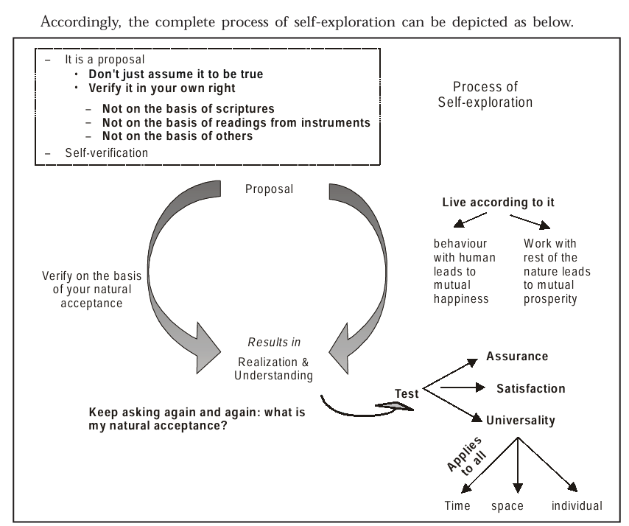

Slide 21
Self Evolution

